Slide 1
Introduction of Transactions and Concurrency Control
Transaction Concept
ACID Properties
Transaction State
Challenge of Concurrent Executions
Serializability
Schedule
Testing for Serializability
Recoverability
Concurrency Control
Lock-Based Protocols
Deadlock Handling
Multiple Granularity
Levels of Consistency

Slide 2
Transaction Concept
E.g. Transaction to transfer $50 from account A to account B:
1. read(A) 4. read(B)
2. A := A – 50 5. B := B + 50
3. write(A) 6. write(B
A transaction is a unit of program execution that accesses and possibly updates various data items.
A transaction must see a consistent database.
During transaction execution the database may be inconsistent.
When the transaction is committed, the database must be consistent.
Two main issues to deal with:
Failures of various kinds, such as hardware failures and system crashes, including the error of DBMS itself!
Concurrent execution of multiple transactions

Slide 3
Required Properties of a Transaction
Consider a transaction to transfer $50 from account A to account B:
1. read(A) 4. read(B)
2. A := A – 50 5. B := B + 50
3. write(A) 6. write(B)
Atomicity requirement
If the transaction fails after step 3 and before step 6, money will be “lost” leading to an inconsistent database state
Failure could be due to software or hardware
The system should ensure that updates of a partially executed transaction are not reflected in the database
Durability requirement
once the user has been notified that the transaction has completed (i.e., the transfer of the $50 has taken place), the updates to the database by the transaction must persist even if there are software or hardware failures.

Slide 4
Required Properties of a Transaction (Cont.)
Consistency requirement in above example:
The sum of A and B is unchanged by the execution of the transaction
In general, consistency requirements include
Explicitly specified integrity constraints such as primary keys and foreign keys
Implicit integrity constraints
e.g., sum of balances of all accounts, minus sum of loan amounts must equal value of cash-in-hand
A transaction, when starting to execute, must see a consistent database.
During transaction execution the database may be temporarily inconsistent.
When the transaction completes successfully the database must be consistent
Erroneous transaction logic can lead to inconsistency, but this is not the responsibility of DBMS.

Slide 5
Required Properties of a Transaction (Cont.)
Isolation requirement — if between steps 3 and 6 (of the fund transfer transaction) , another transaction T2 is allowed to access the partially updated database, it will see an inconsistent database (the sum A + B will be less than it should be).
T1 T2
1. read(A)
2. A := A – 50
3. write(A) read(A), read(B), print(A+B)
4. read(B)
5. B := B + 50
6. write(B
Isolation can be ensured trivially by running transactions serially
That is, one after the other.
However, executing multiple transactions concurrently has significant benefits, as we will see later.

Slide 6
ACID Properties
To preserve integrity of data, the database system must ensure:
Atomicity. Either all operations of the transaction are properly reflected in the database or none are.
Commit a transaction
Rollback a transaction
Consistency. Execution of a transaction in isolation preserves the consistency of the database.
Isolation. Although multiple transactions may execute concurrently, each transaction must be unaware of other concurrently executing transactions. Intermediate transaction results must be hidden from other concurrently executed transactions.
Durability. After a transaction completes successfully, the changes it has made to the database persist, even if there are system failures.

Slide 7
Transaction State
Active – the initial state; the transaction stays in this state while it is executing
Partially committed – after the final statement has been executed.
Failed -- after the discovery that normal execution can no longer proceed.
Aborted – after the transaction has been rolled back and the database restored to its state prior to the start of the transaction. Two options after it has been aborted:
Restart the transaction
can be done only if no internal logical error
Kill the transaction
Committed – after successful completion.

Slide 8
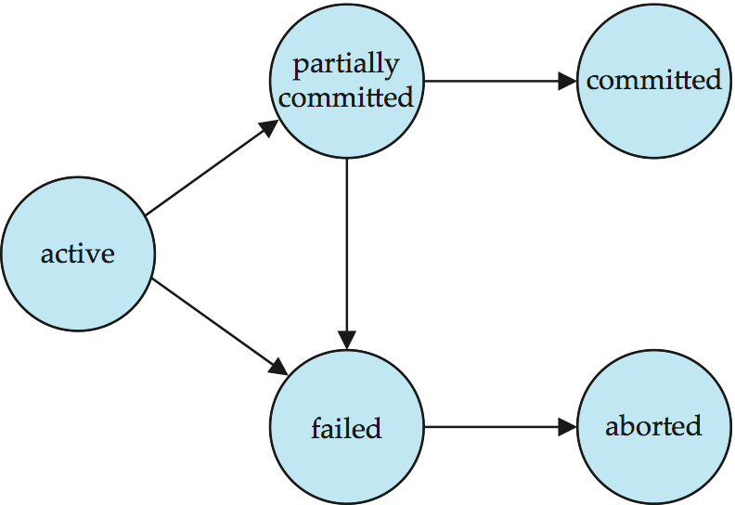
Transaction State (Cont.)
Single step

Slide 9
Concurrent Executions
Multiple transactions are allowed to run concurrently in the system. Advantages are:
Increased processor and disk utilization, leading to better transaction throughput
E.g. one transaction can be using the CPU while another is reading from or writing to the disk
Reduced average response time for transactions: short transactions need not wait behind long ones.
Concurrency control schemes – mechanisms to achieve isolation
That is, to control the interaction among the concurrent transactions in order to prevent them from destroying the consistency of the database

Slide 10
Consistency problems of concurrent Execution without control
Lost modification:
Dirty Read:
 | T1 | T2
1 | Read(x)
2 |  | Read(x)
3 | X = x+1
4 | Write(x) | X = x*2
5 |  | Write(x)
 | T1 | T2
1 | Write(x)
2 |  | Read(x)
3 | rollback

Slide 11
Consistency problems (Cont.)
Non repeatable read
 | T1 | T2
1 | Read(x)
2 |  | Write(x)
3 | Read(x)
 | X ?

Slide 12
Schedules
Schedule – a sequences of instructions that specify the chronological order in which instructions of concurrent transactions are executed
a schedule for a set of transactions must consist of all instructions of those transactions
must preserve the order in which the instructions appear in each individual transaction.
The last step of a transaction
A transaction that successfully completes its execution will have a commit instructions as the last statement
A transaction that fails to successfully complete its execution will have an abort instruction as the last statement
Some notions:
Serial Schedule
Equivalent schedule
Serializable Schedule

Slide 13
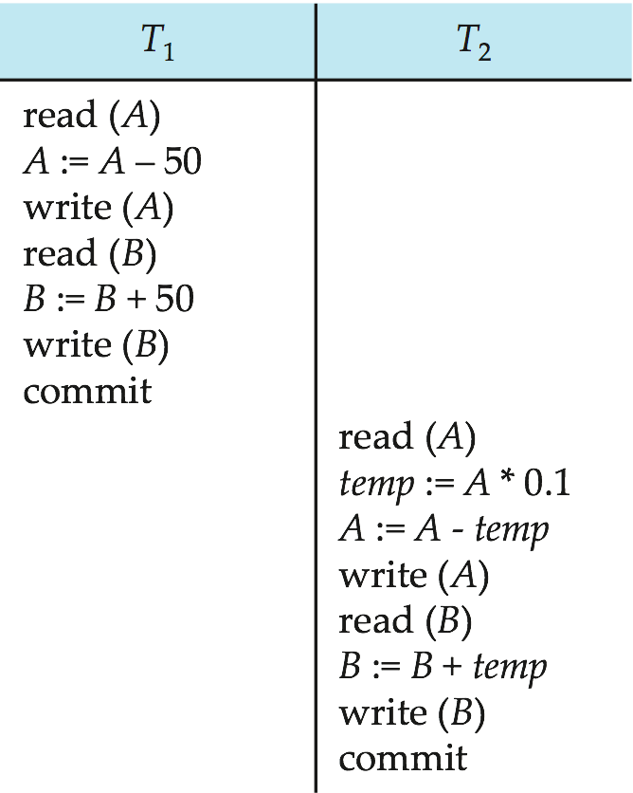
Schedule 1
Let T₁ transfer $50 from A to B, and T₂ transfer 10% of the balance from A to B.
An example of a serial schedule in which T₁ is followed by T₂ :

Slide 14
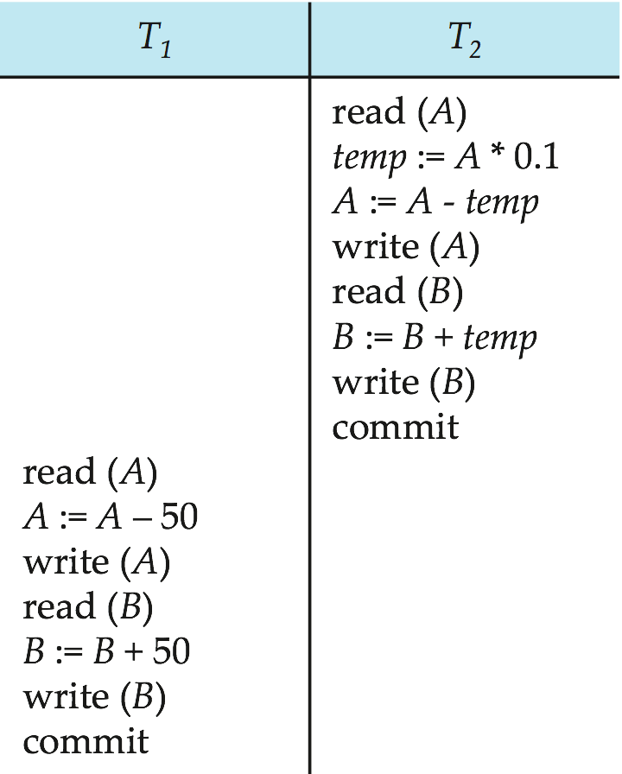
Schedule 2
A serial schedule in which T₂ is followed by T₁ :

Slide 15
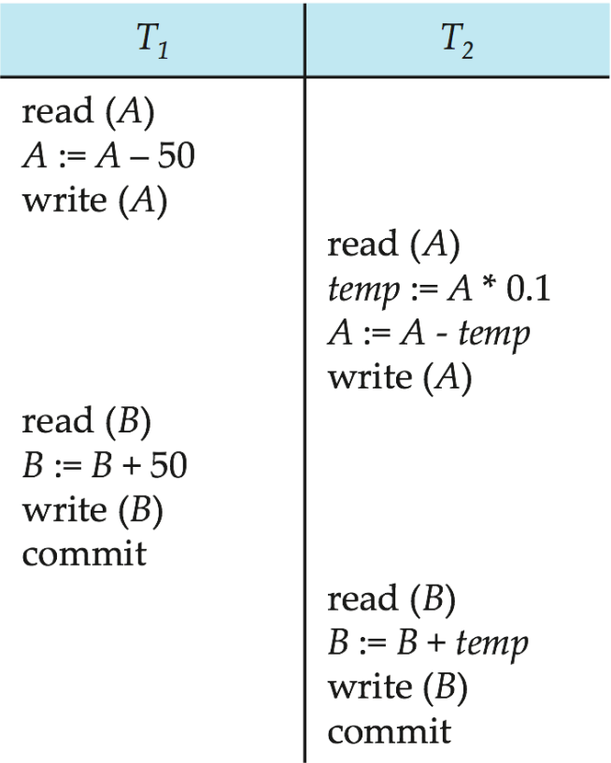
Schedule 3
Let T₁ and T₂ be the transactions defined previously. The following schedule is not a serial schedule, but it is equivalent to Schedule 1.
Note -- In schedules 1, 2 and 3, the sum “A + B” is preserved.

Slide 16
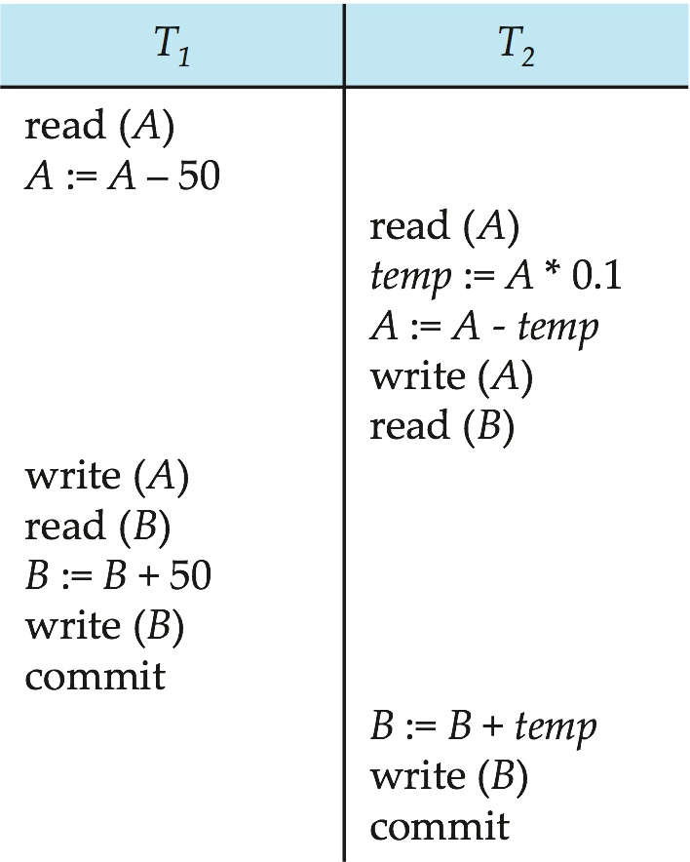
Schedule 4
The following concurrent schedule does not preserve the sum of “A + B”

Slide 17
Serializability
Basic Assumption
Each transaction preserves database consistency.
We ignore operations other than read and write instructions, and we assume that transactions may perform arbitrary computations on data in local buffers in between reads and writes. Our simplified schedules consist of only read and write instructions.
Thus serial execution of a set of transactions preserves database consistency.
A (possibly concurrent) schedule is serializable if it is equivalent to a serial schedule.
How to determine a schedule is equivalent to a serial schedule?
Different forms of schedule equivalence give rise to the notions of:
1. conflict serializability
2. view serializability

Slide 18
Conflicting Instructions
Instructions l_{i} and l_{j} of transactions T_{i} and T_{j} respectively, conflict if and only if there exists some item Q accessed by both l_{i} and l_{j}, and at least one of these instructions wrote Q.
1. l_{i} = read(Q), l_{j} = read(Q). l_{i} and l_{j} don’t conflict. 2. l_{i} = read(Q), l_{j} = write(Q). They conflict. 3. l_{i} = write(Q), l_{j} = read(Q). They conflict 4. l_{i} = write(Q), l_{j} = write(Q). They conflict
Intuitively, a conflict between l_{i} and l_{j} forces a (logical) temporal order between them.
If l_{i} and l_{j} are consecutive in a schedule and they do not conflict, their results would remain the same even if they had been interchanged in the schedule.

Slide 19
Conflict Serializability
If a schedule S can be transformed into a schedule S´ by a series of swaps of non-conflicting instructions, we say that S and S´ are conflict equivalent.
We say that a schedule S is conflict serializable if it is conflict equivalent to a serial schedule
Example of a schedule that is not conflict serializable:
T₃ T₄ read(Q) write(Q) write(Q) We are unable to swap instructions in the above schedule to obtain either the serial schedule < T₃, T₄ >, or the serial schedule < T₄, T₃ >.

Slide 20
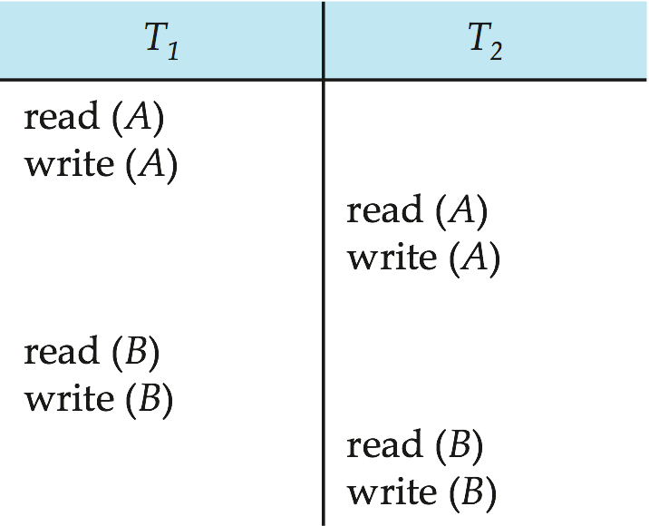
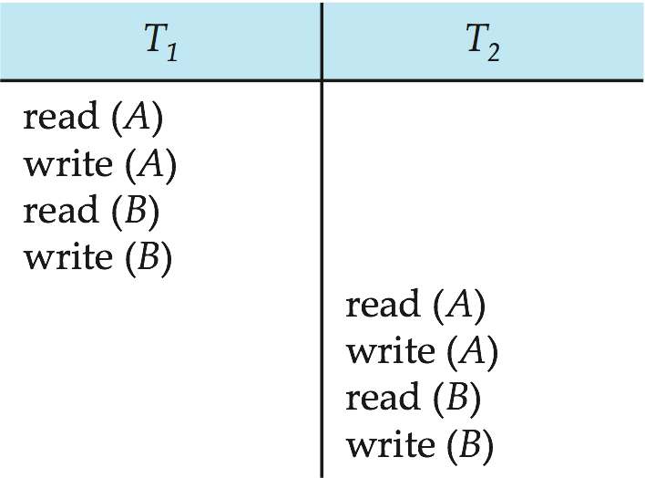
Conflict Serializability (Cont.)
Schedule 3 can be transformed into Schedule 6 -- a serial schedule where T₂ follows T₁, by a series of swaps of non-conflicting instructions. Therefore, Schedule 3 is conflict serializable.
Schedule 3
Schedule 6

Slide 21
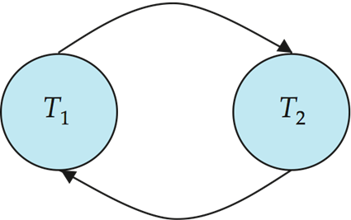
Testing for Serializability
Consider some schedule of a set of transactions T₁, T₂, ..., T_{n}
Precedence graph — a direct graph where the vertices are the transactions (names).
We draw an arc from T_{i} to T_{j} if the two transaction conflict, and T_{i} accessed the data item on which the conflict arose earlier.
We may label the arc by the item that was accessed.
Example
A
B

Slide 22
Example Schedule (Schedule A)
T₁ T₂ T₃ T₄ T₅ read(X) read(Y) read(Z) read(V) read(W) read(W) read(Y) write(Y) write(Z) read(U) read(Y) write(Y) read(Z) write(Z)
read(U) write(U)

Slide 23
Precedence Graph for Schedule A
T₁
T₂
T₅
T₄
T₃

Slide 24
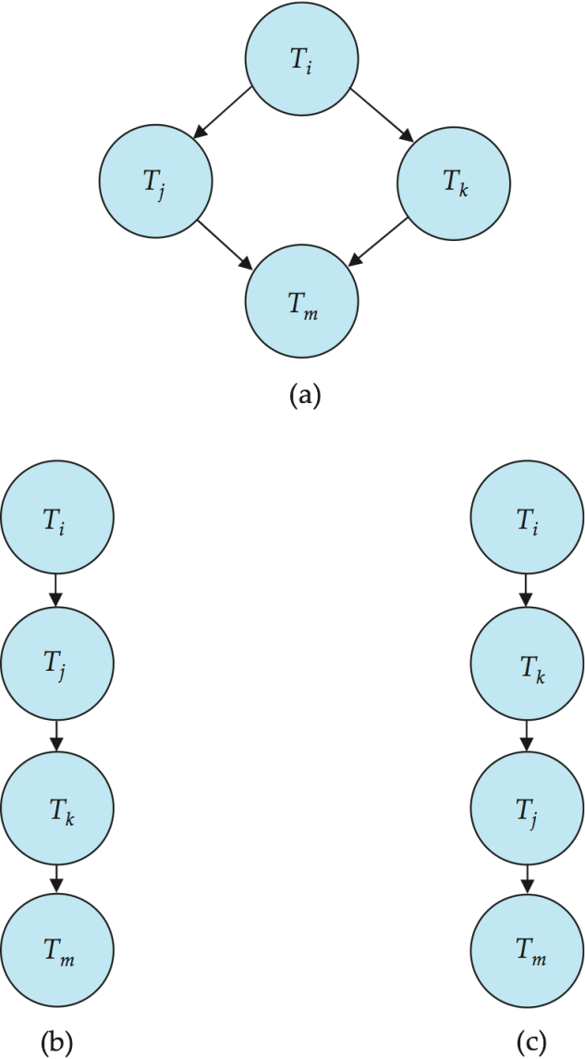
Testing for Conflict Serializability
A schedule is conflict serializable if and only if its precedence graph is acyclic.
Cycle-detection algorithms exist which take order n² time, where n is the number of vertices in the graph.
(Better algorithms take order n + e where e is the number of edges.)
If precedence graph is acyclic, the serializability order can be obtained by a topological sorting of the graph.
That is, a linear order consistent with the partial order of the graph.
For example, a serializability order for the schedule (a) would be one of either (b) or (c)

Slide 25
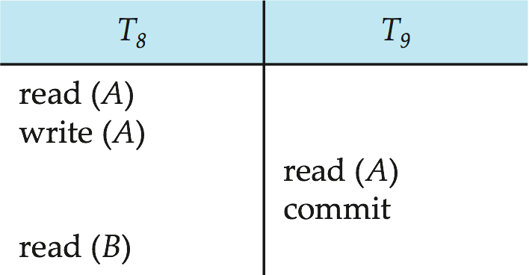
Recoverable Schedules
Recoverable schedule — if a transaction T_{j} reads a data item previously written by a transaction T_{i} , then the commit operation of T_{i} must appear before the commit operation of T_{j}.
The following schedule is not recoverable if T₉ commits immediately after the read(A) operation.
If T₈ should abort, T₉ would have read (and possibly shown to the user) an inconsistent database state. Hence, database must ensure that schedules are recoverable.

Slide 26
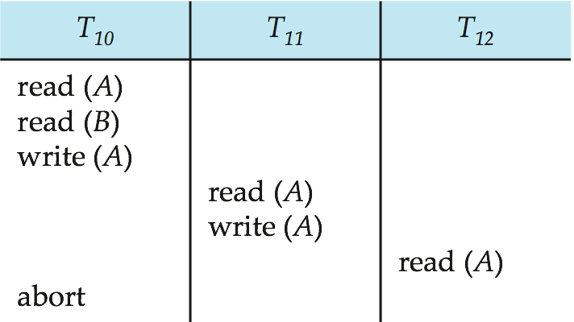
Cascading Rollbacks
Cascading rollback – a single transaction failure leads to a series of transaction rollbacks. Consider the following schedule where none of the transactions has yet committed (so the schedule is recoverable) If T₁₀ fails, T₁₁ and T₁₂ must also be rolled back.
Can lead to the undoing of a significant amount of work
Theoretically, it is not mandatory to avoid cascading rollback.

Slide 27
Cascadeless Schedules
Cascadeless schedules — for each pair of transactions T_{i} and T_{j} such that T_{j} reads a data item previously written by T_{i}, the commit operation of T_{i} appears before the read operation of T_{j}.
Every cascadeless schedule is also recoverable
It is desirable to restrict the schedules to those that are cascadeless
Example of a schedule that is NOT cascadeless

Slide 28
Concurrency Control
A database must provide a mechanism that will ensure that all possible schedules are both:
serializable.
Recoverable and preferably cascadeless
A policy in which only one transaction can execute at a time generates serial schedules, but provides a poor degree of concurrency
Concurrency-control schemes tradeoff between the amount of concurrency they allow and the amount of overhead that they incur
Testing a schedule for serializability after it has executed is a little too late!
Tests for serializability help us understand why a concurrency control protocol is correct
Goal – to develop concurrency control protocols that will assure serializability.

Slide 29
Concurrency Control Protocols
Lock-Based Protocols
Deadlock Handling
Multiple Granularity

Slide 30
Lock-Based Protocols
A lock is a mechanism to control concurrent access to a data item
Data items can be locked in two modes :
1. exclusive (X) mode. Data item can be both read as well as
written. X-lock is requested using lock-X instruction.
2. shared (S) mode. Data item can only be read. S-lock is
requested using lock-S instruction.
Lock requests are made to concurrency-control manager. Transaction can proceed only after request is granted.

Slide 31
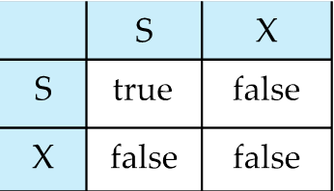
Lock-Based Protocols (Cont.)
Lock-compatibility matrix
A transaction may be granted a lock on an item if the requested lock is compatible with locks already held on the item by other transactions
Any number of transactions can hold shared locks on an item, but if any transaction holds an exclusive on the item no other transaction may hold any lock on the item.
If a lock cannot be granted, the requesting transaction is made to wait till all incompatible locks held by other transactions have been released. The lock is then granted.

Slide 32
Lock-Based Protocols (Cont.)
Example of a transaction performing locking:
T₂: lock-S(A);
read (A);
unlock(A);
lock-S(B);
read (B);
unlock(B);
display(A+B)
Locking as above is not sufficient to guarantee serializability
if A and B get updated in-between the read of A and B, the displayed sum would be wrong.
A locking protocol is a set of rules followed by all transactions while requesting and releasing locks. Locking protocols restrict the set of possible schedules.

Slide 33
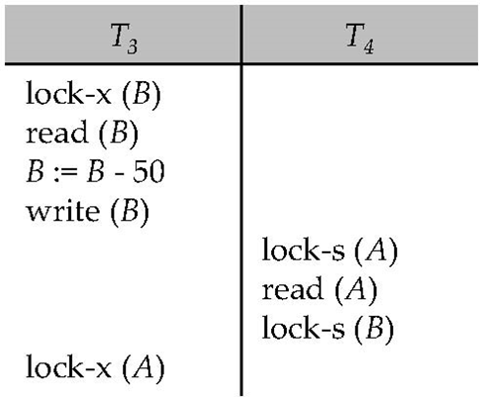
Pitfalls of Lock-Based Protocols
Consider the partial schedule
Neither T₃ nor T₄ can make progress — executing lock-S(B) causes T₄ to wait for T₃ to release its lock on B, while executing lock-X(A) causes T₃ to wait for T₄ to release its lock on A.
Such a situation is called a deadlock.
To handle a deadlock one of T₃ or T₄ must be rolled back and its locks released.

Slide 34
Pitfalls of Lock-Based Protocols (Cont.)
The potential for deadlock exists in most locking protocols. Deadlocks are a necessary evil.
Starvation is also possible if concurrency control manager is badly designed. For example:
A transaction may be waiting for an X-lock on an item, while a sequence of other transactions request and are granted an S-lock on the same item.
The same transaction is repeatedly rolled back due to deadlocks.
Concurrency control manager can be designed to prevent starvation.

Slide 35
The Two-Phase Locking Protocol
Two-Phase Locking is a protocol which ensures conflict-serializable schedules.
Phase 1: Growing Phase
transaction may obtain locks
transaction may not release locks
Phase 2: Shrinking Phase
transaction may release locks
transaction may not obtain locks
The protocol assures serializability. It can be proved that the transactions can be serialized in the order of their lock points (i.e. the point where a transaction acquired its final lock).

Slide 36
The Two-Phase Locking Protocol (Cont.)
Two-phase locking does not ensure freedom from deadlocks
Cascading roll-back is possible under two-phase locking. To avoid this, follow a modified protocol called strict two-phase locking. Here a transaction must hold all its exclusive locks till it commits/aborts.
Rigorous two-phase locking is even stricter: here all locks are held till commit/abort. In this protocol transactions can be serialized in the order in which they commit.
Strict two-phase locking and rigorous two-phase locking(with lock conversions) are used extensively in DBMS.

Slide 37
The Two-Phase Locking Protocol (Cont.)
There may be conflict serializable schedules that cannot be obtained through two-phase locking protocol.
To obtain conflict serializable schedules though non-two-phase locking protocol, we need:
Either to have additional information about the transactions
Or to impose some structure or ordering on the set of date items in the database.

Slide 38
Lock Conversions
Lock Conversions: Only acquire X lock when necessary.
Provide a mechanism for upgrading a S lock to a X lock.
Two-phase locking with lock conversions:
– First Phase:
can acquire a lock-S on item
can acquire a lock-X on item
can convert a lock-S to a lock-X (upgrade)
– Second Phase:
can release a lock-S
can release a lock-X
can convert a lock-X to a lock-S (downgrade)
This protocol assures serializability. But still relies on the programmer to insert the various locking instructions.

Slide 39
Automatic Acquisition of Locks (Commercial DBMS Uses)
A transaction T_{i} issues the standard read/write instruction, without explicit locking calls.
The operation read(D) is processed as:
if T_{i} has a lock on D
then
read(D)
else
begin
if necessary wait until no other
transaction has a lock-X on D
grant T_{i} a lock-S on D;
read(D)
end

Slide 40
Automatic Acquisition of Locks (Cont.)
write(D) is processed as:
if T_{i} has a lock-X on D
then
write(D)
else
begin
if necessary wait until no other trans. has any lock on D,
if T_{i} has a lock-S on D
then
upgrade lock on D to lock-X
else
grant T_{i} a lock-X on D
write(D)
end;
All locks are released after commit or abort

Slide 41
Implementation of Locking
A Lock manager can be implemented as a separate process to which transactions send lock and unlock requests
The lock manager replies to a lock request by sending a lock grant messages (or a message asking the transaction to roll back, in case of a deadlock)
The requesting transaction waits until its request is answered
The lock manager maintains a data structure called a lock table to record granted locks and pending requests
The lock table is usually implemented as an in-memory hash table indexed on the name of the data item being locked

Slide 42
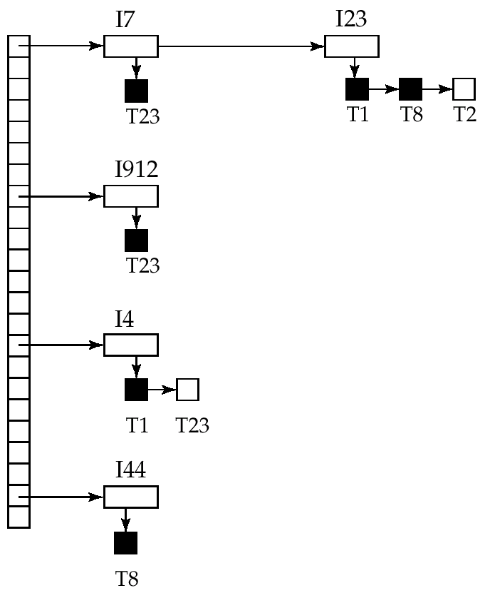
Lock Table
Black rectangles indicate granted locks, white ones indicate waiting requests
Lock table also records the type of lock granted or requested
New request is added to the end of the queue of requests for the data item, and granted if it is compatible with all earlier locks
Unlock requests result in the request being deleted, and later requests are checked to see if they can now be granted
If transaction aborts, all waiting or granted requests of the transaction are deleted
lock manager may keep a list of locks held by each transaction, to implement this efficiently

Slide 43
Deadlock Handling
System is deadlocked if there is a set of transactions such that every transaction in the set is waiting for another transaction in the set.
Deadlock prevention protocols ensure that the system will never enter into a deadlock state. Some prevention strategies :
Require that each transaction locks all its data items before it begins execution (predeclaration).
Impose partial ordering of all data items and require that a transaction can lock data items only in the order specified by the partial order (graph-based protocol).

Slide 44
More Deadlock Prevention Strategies
Following schemes use transaction timestamps for the sake of deadlock prevention alone.
wait-die scheme — non-preemptive
older transaction may wait for younger one to release data item. Younger transactions never wait for older ones; they are rolled back instead.
a transaction may die several times before acquiring needed data item
wound-wait scheme — preemptive
older transaction wounds (forces rollback) of younger transaction instead of waiting for it. Younger transactions may wait for older ones.
may be fewer rollbacks than wait-die scheme.

Slide 45
Wait-die vs. Wound-wait
Three transactions: A, B , C ordered by starting time. B held a lock on data item Y. Then
 | Wait-die | Wound-wait
A acquire Y | Wait | B rollback; A granted the lock on Y
C acquire Y | C rollback | Wait

Slide 46
Deadlock prevention (Cont.)
Both in wait-die and in wound-wait schemes, a rolled back transactions is restarted with its original timestamp. Older transactions thus have precedence over newer ones, and starvation is hence avoided.
Timeout-Based Schemes :
a transaction waits for a lock only for a specified amount of time. After that, the wait times out and the transaction is rolled back.
thus deadlocks are not possible
simple to implement; but starvation is possible. Also difficult to determine good value of the timeout interval.

Slide 47
Deadlock Detection
Deadlocks can be described as a wait-for graph, which consists of a pair G = (V,E),
V is a set of vertices (all the transactions in the system)
E is a set of edges; each element is an ordered pair T_{i} →T_{j}.
If T_{i} → T_{j} is in E, then there is a directed edge from T_{i} to T_{j}, implying that T_{i} is waiting for T_{j} to release a data item.
When T_{i} requests a data item currently being held by T_{j}, then the edge T_{i} T_{j} is inserted in the wait-for graph. This edge is removed only when T_{j} is no longer holding a data item needed by T_{i}.
The system is in a deadlock state if and only if the wait-for graph has a cycle. Must invoke a deadlock-detection algorithm periodically to look for cycles.

Slide 48
Deadlock Detection (Cont.)
Wait-for graph without a cycle
Wait-for graph with a cycle

Slide 49
Deadlock Recovery
When deadlock is detected :
Some transaction will have to rolled back (made a victim) to break deadlock. Select that transaction as victim that will incur minimum cost.
Rollback -- determine how far to roll back transaction
Total rollback: Abort the transaction and then restart it.
Partial rollback: More effective to roll back transaction only as far as necessary to break deadlock. Partial rollback requires the system to maintain additional information about the running trasactions.
Starvation happens if same transaction is always chosen as victim. Include the number of rollbacks in the cost factor to avoid starvation

Slide 50
Multiple Granularity
Allow data items to be of various sizes and define a hierarchy of data granularities, where the small granularities are nested within larger ones
Can be represented graphically as a tree
When a transaction locks a node in the tree explicitly, it implicitly locks all the node's descendents in the same mode.
Granularity of locking (level in tree where locking is done):
fine granularity (lower in tree): high concurrency, high locking overhead
coarse granularity (higher in tree): low locking overhead, low concurrency

Slide 51
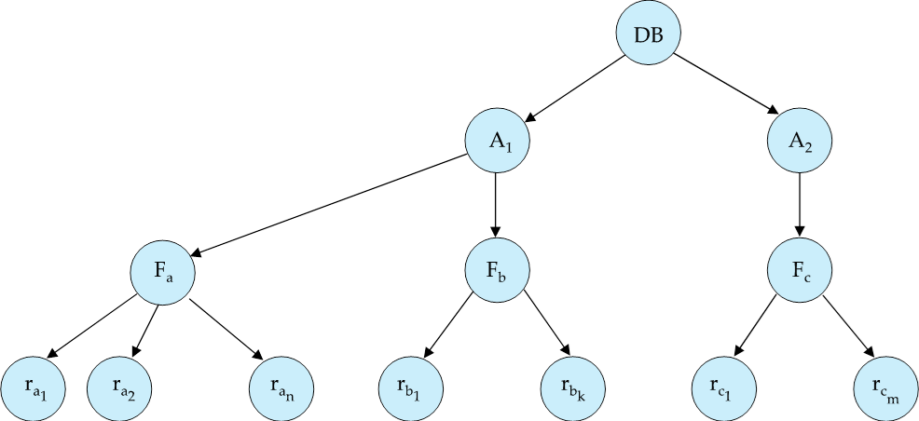
Example of Granularity Hierarchy
The highest level in the example hierarchy is the entire database.
The levels below are of type area, file and record in that order.

Slide 52
Intention Lock Modes
In addition to S and X lock modes, there are three additional lock modes with multiple granularity:
intention-shared (IS): indicates explicit locking at a lower level of the tree but only with shared locks.
intention-exclusive (IX): indicates explicit locking at a lower level with exclusive or shared locks
shared and intention-exclusive (SIX): the subtree rooted by that node is locked explicitly in shared mode and explicit locking is being done at a lower level with exclusive-mode locks.
intention locks allow a higher level node to be locked in S or X mode without having to check all descendent nodes.

Slide 53
Compatibility Matrix with Intention Lock Modes
The compatibility matrix for all lock modes is:
IS
IX
S
S IX
X
IS
✓
✓
✓
✓
×
IX
✓
✓
×
×
×
S
✓
×
✓
×
×
S IX
✓
×
×
×
×
X
×
×
×
×
×

Slide 54
Multiple Granularity Locking Scheme
Transaction T_{i} can lock a node Q, using the following rules:
1. The lock compatibility matrix must be observed.
2. The root of the tree must be locked first, and may be locked in any mode.
3. A node Q can be locked by T_{i} in S or IS mode only if the parent of Q is currently locked by T_{i} in either IX or IS mode.
4. A node Q can be locked by T_{i} in X, SIX, or IX mode only if the parent of Q is currently locked by T_{i} in either IX or SIX mode.
5. T_{i} can lock a node only if it has not previously unlocked any node
(that is, T_{i} is two-phase locking).
6. T_{i} can unlock a node Q only if none of the children of Q are currently locked by T_{i}.
Observe that locks are acquired in root-to-leaf order, whereas they are released in leaf-to-root order.
Lock granularity escalation: in case there are too many locks at a particular level, switch to higher granularity S or X lock

Slide 55
Weak Levels of Consistency
Some applications are willing to live with weak levels of consistency, allowing schedules that are not serializable
E.g., a read-only transaction that wants to get an approximate total balance of all accounts
E.g., database statistics computed for query optimization can be approximate (why?)
Such transactions need not be serializable with respect to other transactions
Tradeoff accuracy for performance

Slide 56
Levels of Consistency in SQL-92
Serializable — default
Repeatable read — only committed records to be read, repeated reads of same record must return same value. However, a transaction may not be serializable – it may find some records inserted by a transaction but not find others.
The phantom Phenomenon
Read committed — only committed records can be read, but successive reads of record may return different (but committed) values.
Read uncommitted — even uncommitted records may be read.
Lower degrees of consistency useful for gathering approximate information about the database, e.g., statistics for query optimizer.

Slide 57
End of Lecture

Slide 58
View Serializability
Let S and S´ be two schedules with the same set of transactions. S and S´ are view equivalent if the following three conditions are met:
1. For each data item Q, if transaction T_{i} reads the initial value of Q in schedule S, then transaction T_{i} must, in schedule S´, also read the initial value of Q.
2. For each data item Q if transaction T_{i} executes read(Q) in schedule S, and that value was produced by transaction T_{j} (if any), then transaction T_{i} must in schedule S´ also read the value of Q that was produced by transaction T_{j} .
3. For each data item Q, the transaction (if any) that performs the final write(Q) operation in schedule S must perform the final write(Q) operation in schedule S´.
As can be seen, view equivalence is also based purely on reads
and writes alone.

Slide 59
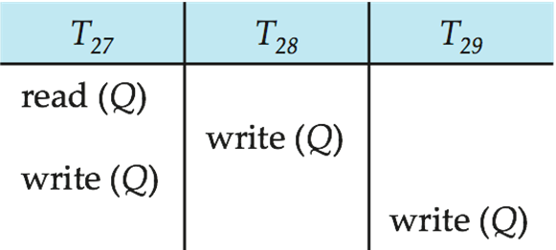
View Serializability (Cont.)
A schedule S is view serializable it is view equivalent to a serial schedule.
Every conflict serializable schedule is also view serializable.
Below is a schedule which is view-serializable but not conflict serializable.
Every view serializable schedule that is not conflict serializable has blind writes (write(Q) without having performed a read(Q) operation).

Slide 60
Timestamp-Based Protocols
Each transaction is issued a timestamp when it enters the system. If an old transaction T_{i} has time-stamp TS(T_{i}), a new transaction T_{j} is assigned time-stamp TS(T_{j}) such that TS(T_{i}) <TS(T_{j}).
The protocol manages concurrent execution such that the time-stamps determine the serializability order.
In order to assure such behavior, the protocol maintains for each data Q two timestamp values:
W-timestamp(Q) is the largest time-stamp of any transaction that executed write(Q) successfully.
R-timestamp(Q) is the largest time-stamp of any transaction that executed read(Q) successfully.

Slide 61
Timestamp-Based Protocols (Cont.)
The timestamp ordering protocol ensures that any conflicting read and write operations are executed in timestamp order.
Suppose a transaction T_{i} issues a read(Q)
If TS(T_{i}) ≤ W-timestamp(Q), then T_{i} needs to read a value of Q that was already overwritten.
Hence, the read operation is rejected, and T_{i} is rolled back.
If TS(T_{i}) ≥ W-timestamp(Q), then the read operation is executed, and R-timestamp(Q) is set to max(R-timestamp(Q), TS(T_{i})).

Slide 62
Timestamp-Based Protocols (Cont.)
Suppose that transaction T_{i} issues write(Q).
If TS(T_{i}) < R-timestamp(Q), then the value of Q that T_{i} is producing was needed previously, and the system assumed that that value would never be produced.
Hence, the write operation is rejected, and T_{i} is rolled back.
If TS(T_{i}) < W-timestamp(Q), then T_{i} is attempting to write an obsolete value of Q.
Hence, this write operation is rejected, and T_{i} is rolled back.
Otherwise, the write operation is executed, and W-timestamp(Q) is set to TS(T_{i}).

Slide 63
Thomas’ Write Rule
Modified version of the timestamp-ordering protocol in which obsolete write operations may be ignored under certain circumstances.
When T_{i} attempts to write data item Q, if TS(T_{i}) < W-timestamp(Q), then T_{i} is attempting to write an obsolete value of {Q}.
Rather than rolling back T_{i} as the timestamp ordering protocol would have done, this {write} operation can be ignored.
Otherwise this protocol is the same as the timestamp ordering protocol.
Thomas' Write Rule allows greater potential concurrency.
Allows some view-serializable schedules that are not conflict-serializable.

Slide 64
Snapshot Isolation
Snapshot isolation is a particular type of concurrency-control scheme that has gained wide acceptance in commercial and open source systems, Oracle, PostgreSQL, SQL Server,etc.
Giving a transaction a “snapshot” of the database at the time when it begins execution
It is ideal for read only transactions since they never wait and aborted.
Updates are kept in the transaction’s private workspace until the transaction successfully commits.
Snapshot Isolation does not always give serializable executions, Integrity constraints can be violated, but very rare

